Slide 1
8강. DQN
Human-level control through deep reinforcement learning
(Minh et al., 2015)

Slide 2
Contents
DQN Overview
Code Review
Pong Game Exercise

Slide 3
DQN Overview
Human-level control through deep RL(Minh et al., 2015)
Solved complex env. and high dimensional input (image)
1st success case using DNN (inspired by AlexNet)
No hand-crafted feature
In Atari 2600 game, the agent is better than an human expert

Slide 4
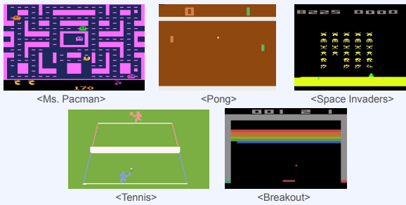
DQN: Environment
Atari 2600 game

Slide 5
DQN: Overview
DQN = Q-learning + Deep Neural Network
Used CNN architecture for input images
Prior to DQN, solutions using neural network has problems.
Learning is unstable or diverge
DQN solved the problem with 2 methods

Slide 6
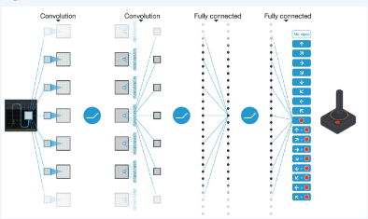
DQN: Neural Network
Neural network that takes images as the input and discrete action value(Q function values) as the output

Slide 7
DQN: Solution to problems
Time-correlated data in an episode
State changes a little, a state may trigger getting the future results
Correlation between data makes learning harder (NOT i.i.d)
Gradients oscillate depending on an episode (optimization is hard)
Generalization for diverse states is very hard
Solution:
Uniformly random sample from the transition data(s, a, r, s') buffer (Experience replay buffer)
Q-learning is off-policy. So, using old data from other distribution is okay

Slide 8
DQN: Solution to problems
Small Q update can completely change a policy
This is especially true for argmax policy case
The policy change cause a big change in data distribution
This means learning from a very dataset than the previous dataset
The learning become unstable
Solution:
Although the policy change dramatically, data distribution sampled from the experience replay buffer do not change so dramatically

Slide 9
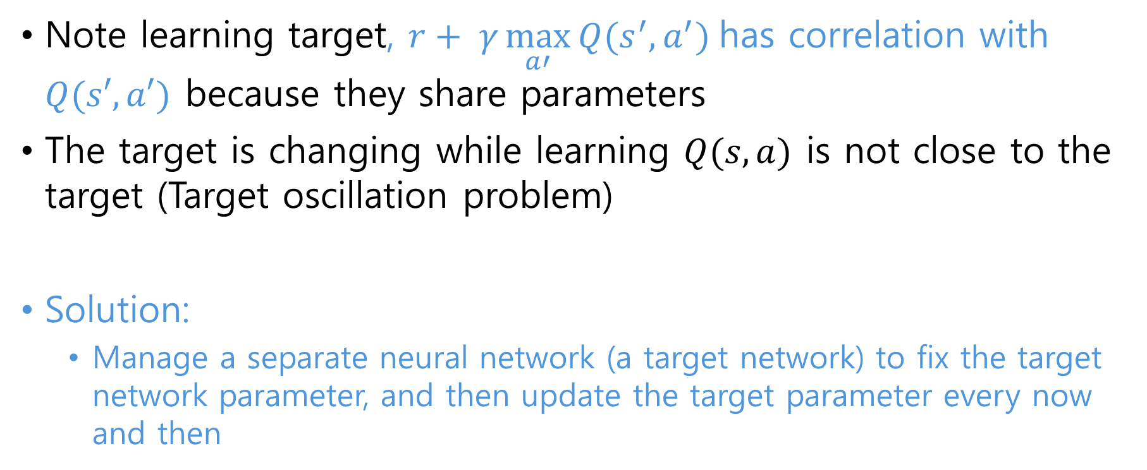
DQN: Solution to problems
Note learning target, $r+ γ\max_{a′}{Q(s^{′}, a^{′})}$has correlation with $Q(s′,a′)$ because they share parameters
The target is changing while learning $Q(s,a)$ is not close to the target (Target oscillation problem)
Solution:
Manage a separate neural network (a target network) to fix the target network parameter, and then update the target parameter every now and then

Slide 10
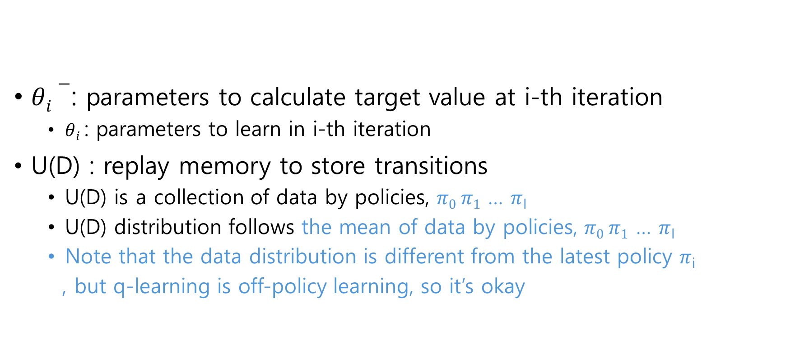
DQN: Loss function
$θi−$: parameters to calculate target value at i-th iteration
$θi$ : parameters to learn in i-th iteration
U(D) : replay memory to store transitions
U(D) is a collection of data by policies, $π0 π1$ … $π$_{I}
U(D) distribution follows the mean of data by policies, $π0 π1$ … $π$_{I}
Note that the data distribution is different from the latest policy $π$_{i}
, but q-learning is off-policy learning, so it’s okay

Slide 11
DQN: State Preprocessing
Original big image size problem:
210x160 (0~127 RGB) image requires memory and computation
‘Flickering’ is a problem:
2 states are the same, but there’s pixel value fluctuation
To solve it, take max. pixel RGB value btw. t-1 pixel and t pixel:
t-1:(57,34,72),
t: (88,34,21)
➔ (88,34,72)

Slide 12
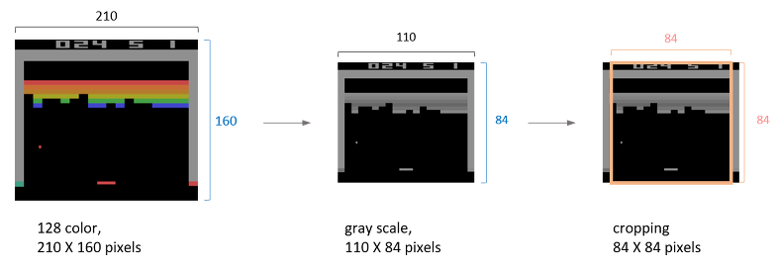
DQN: State Preprocessing
Transform the RGB
into Black and white,
Resizing into 84x84
Stack recent 4 frames
Note the agent could not predict the direction of moving object with 1 image.
The environment is not 1st order Markov property
Using 3 or 5 frame stack shows no different results

Slide 13
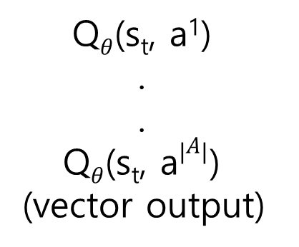
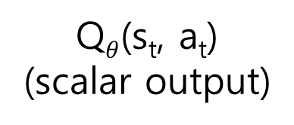
DQN: Q network
If we allows action input, computation is high when argmax:
Instead, output all the action-values of every actions once
s_{t}, a_{t}
(vector input)
NN
Q$θ$(s_{t}, a_{t})
(scalar output)
Q$θ$(s_{t}, a¹)
.
.
Q$θ$(s_{t}, a$\left|A\right|$)
(vector output)
s_{t}
(vector input)
NN

Slide 14
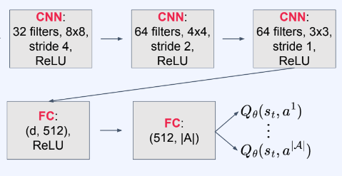
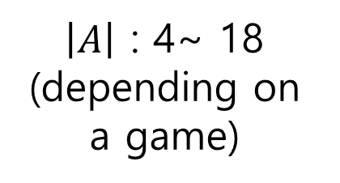
DQN: Q network
Neural Network using CNN
s_{t}
(84,84,4)
$\left|A\right|$ : 4~ 18
(depending on a game)

Slide 15
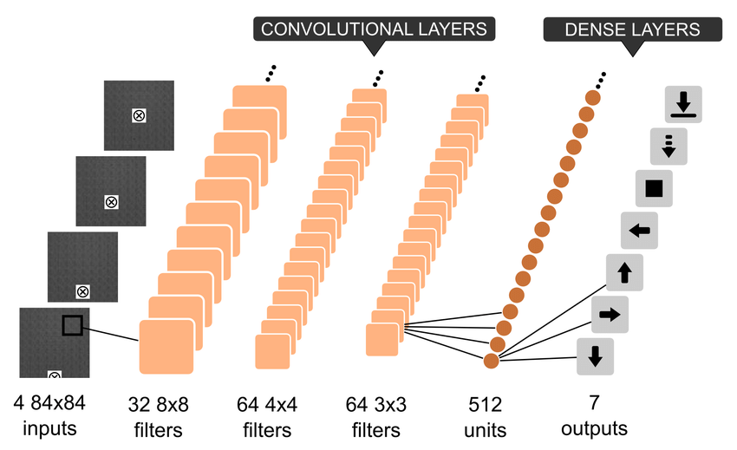
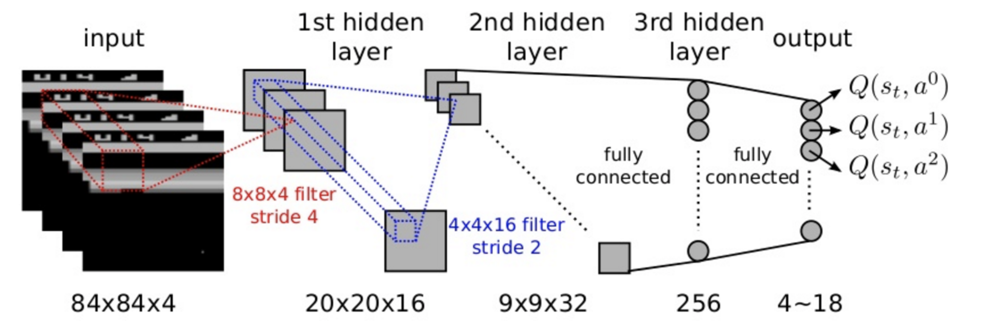
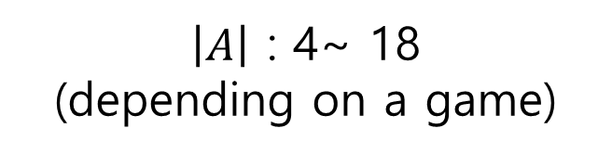
DQN Q network
$\left|A\right|$ : 4~ 18
(depending on a game)

Slide 16
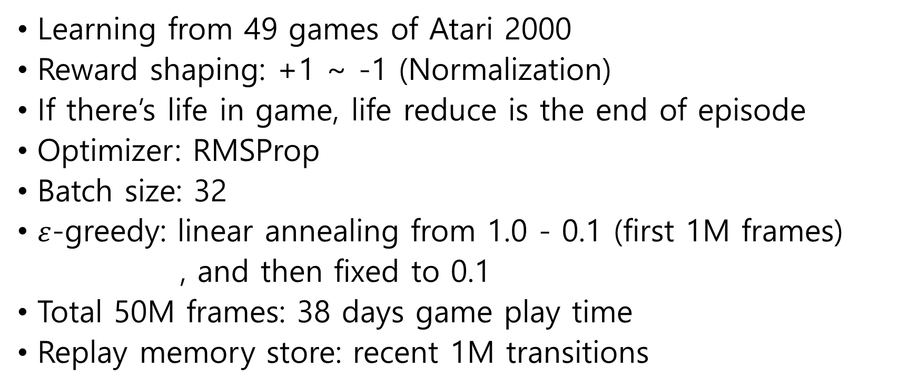
DQN: Training Details
Learning from 49 games of Atari 2000
Reward shaping: +1 ~ -1 (Normalization)
If there’s life in game, life reduce is the end of episode
Optimizer: RMSProp
Batch size: 32
$ε$-greedy: linear annealing from 1.0 - 0.1 (first 1M frames)
, and then fixed to 0.1
Total 50M frames: 38 days game play time
Replay memory store: recent 1M transitions

Slide 17
DQN: Training Details
Frame-skipping (action repeat):
Agent chooses an action every k frame (same actions within k)
Compute cost of game emulation is cheaper than network forward().
Reduces exploration complexity
Hyper-parameter hand tunning:
Extracted for 5 games (Pong, Breakout, Seaquest, Sparce Invaders, Beam Rider), and used the same hyper-parameters for others
Grid search requires too much computation

Slide 18
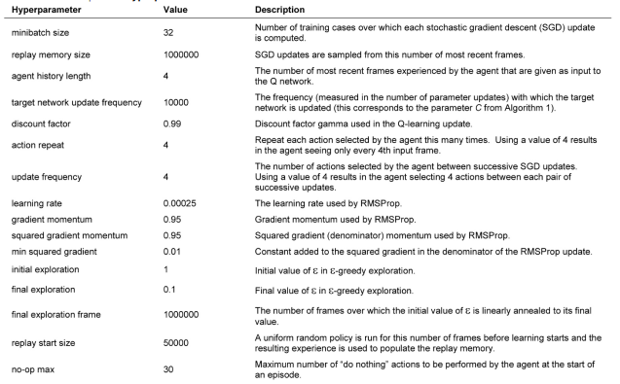
DQN: Hyperparameters

Slide 19
DQN: Evaluation Details
Agent performance is measured by the 30 repeat of 5 min. plays
Epsilon is 0.05 to prevent overfitting in evaluation
Baseline random agent takes an action every 6 frame (10 Hz)
Known fastest response time that a human player can take
Taking an action every frame didn’t make a big difference
(In Boxing, Breakout, Crazy Climber, Demon Attack, Krull
, and Robotank, 5% higher performance)

Slide 20
DQN: Evaluation Details
Human player played 60Hz frame rate w/o sound, pause, or reload.
After 2 hours of practice, a human player performance measured by the 20 repeat of 5 min. plays
To provide diverse starting points, evaluation was started after 30 times no-op
A robust policy does a good job from various starting points

Slide 21
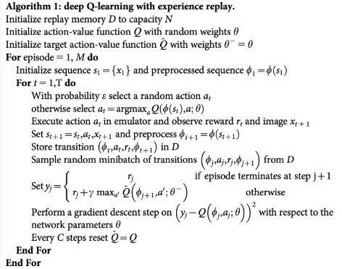
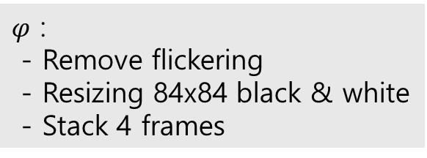
DQN
x_{t}: 210x160 RGB image at t
s_{t} : a stacked 4 images
$φ$ :
- Remove flickering
- Resizing 84x84 black & white
- Stack 4 frames
S_{t+1} : s_{t} contains 1~t states info.

Slide 22
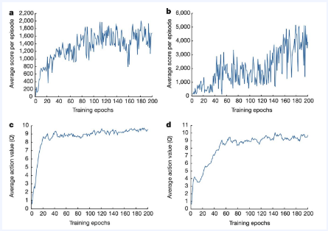
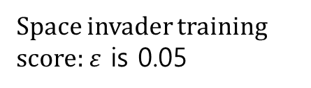
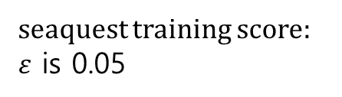
DQN: Results
Space invader training score: $ε$ is 0.05
seaquest training score:
$ε$ is 0.05
Gradient descent every 4 transition
32 batch size x 4 transition = 8 update / sample
Avg. action value is the shaped reward value (Not same scale as avg. return)
Avg. action value while Space invader training
(note: reward shaped)
Avg. action value while seaqeust training
(note: reward shaped)

Slide 23
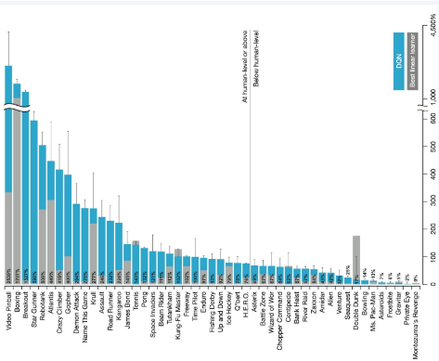
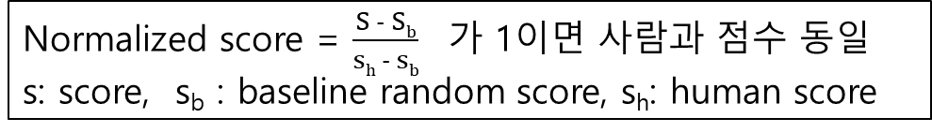
DQN: Results
Assuming human-level is 75% of an expert, DQN is better than humans for 29 / 49
25.4 times better than human
Normalized score = $\frac{S − Sb}{sh − sb}$ 가 1이면 사람과 점수 동일
s: score, s_{b} : baseline random score, s_{h}: human score
Previous SOTA for Atari 2600 is Best linear learner
DQN is better than Best linear leaner in 43 / 49,
without game domain knowledge (only images)

Slide 24
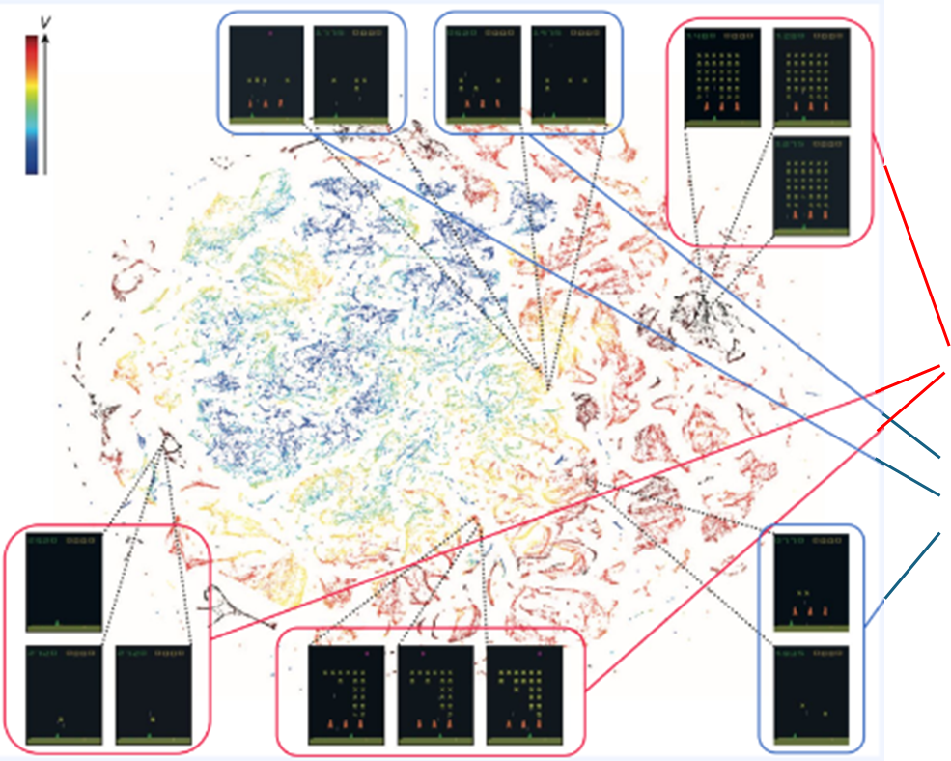
DQN
T-SNE 2 dim. visualization of vector data of the last hidden layer for Space Invaders
Red : high action value
Black : low action value
Similar states has points at similar locations in T-SNE
Although different visually, the states with similar expected reward (action-value) have similar locations

Slide 25
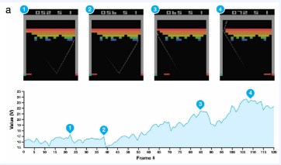
DQN: Results
Agent’s behavior shows that it learned a long-term strategy
E.g., In break out, the agent learned that the state number 4 has much higher value

Slide 26
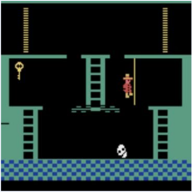
DQN: Results
But DQN suffers in a game like Montejuma’s revenge that requires a longer-term strategy
Sparse reward problem
Deceptive reward problem
Negative Reward occurs when the player hit the skull: deceptive reward

Slide 27
Code Ex.
Python libraries:
gym==0.25.1
ale-py==0.7.5
torch==2.0.0 (cpu버전)
tensorboard==2.13.0
*pip install gym[accept-rom-license]
Code files:
Configuration.py
dqn_agent.py
eval.py
utils.py

Slide 28
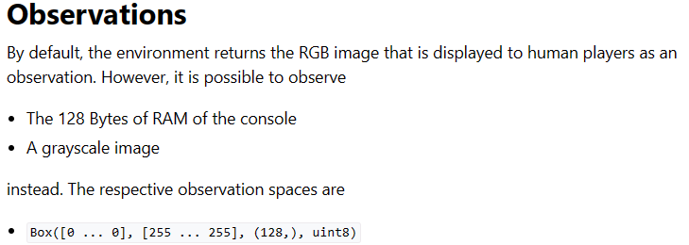
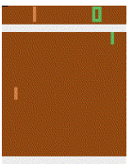

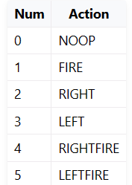
Code Ex. : Pong
‘Pong-ram-v0’ version has 128 state (1 dim. vector)
We’ll use ‘Pong-ram-v0’ version

Slide 29
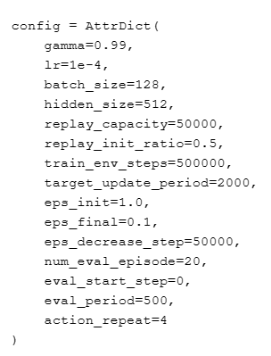
Confgiration.py
Dictionary that allows access to the key value by an attribute (e.g., config.gamma)
Roughly proportional to the complexity of game
50000 samples
Initial buffer-filling ratio before start learning
Total 500000 steps interaction
Target network update per 2000 steps
Epsilon decaying
Stop decaying after 50000 steps
Use avg. of 20 episodes to evaluate score
evaluate every 500 step

Slide 30
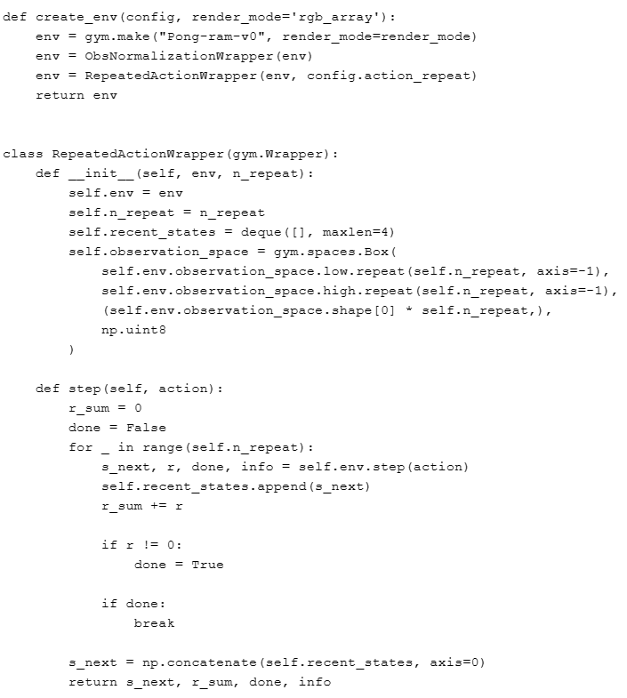
Utils.py
Env return RBG image
Customize pong-v0
Repeat env.observation_space.low 4 times and concatenation
128 * 4 = (512,)

Slide 31
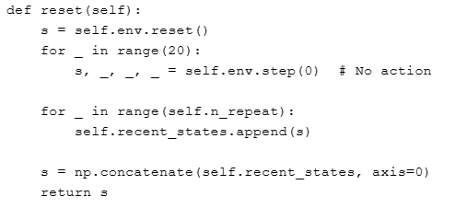
Utils.py
4 times same actions
20 steps No-op
Add reward 4 times
Win: 1, Lose: -1.
To simply training, pong game ends after 1 match.
Concatenate 4 recent states

Slide 32
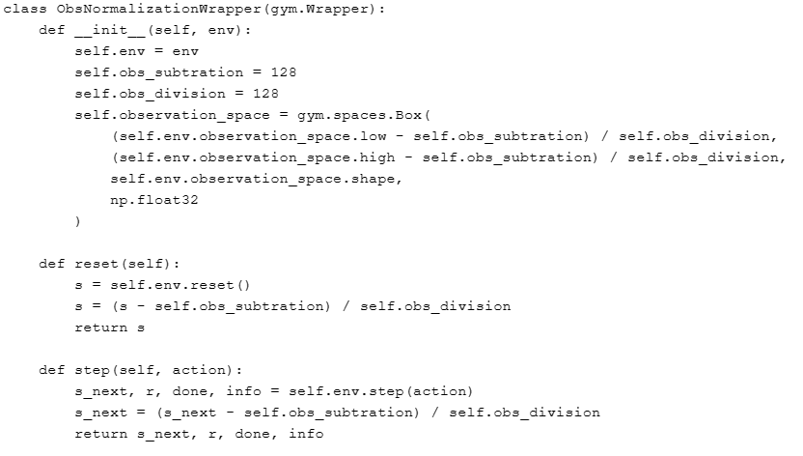
Utils.py
Customize pong-v0
Normalization to -1 ~ 1
No change in shape

Slide 33
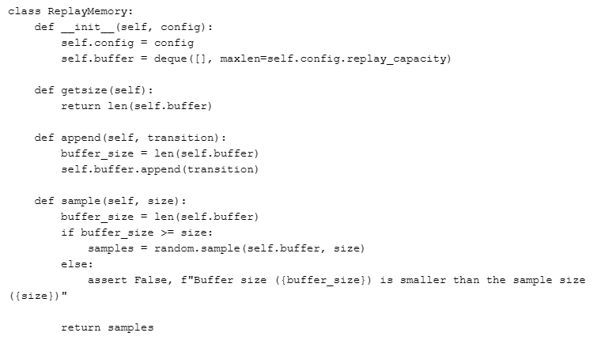
Agent learning (dqn_agent.py)
Attribute dictionary that allows access to the key value by attribute
Uniform random sampling
Assert False …. force the program to end

Slide 34
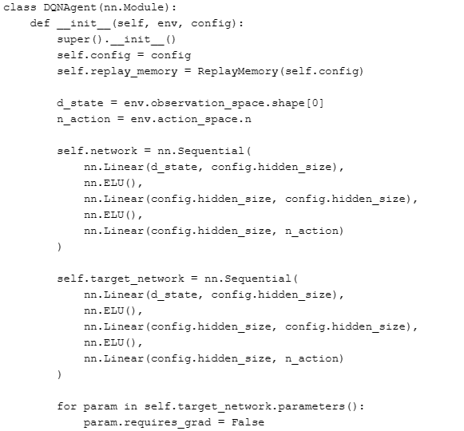
nn.Module init. is required
…
Get State dims., action dims. to design the neural network
Parameters in the target network will have no gradients

Slide 35
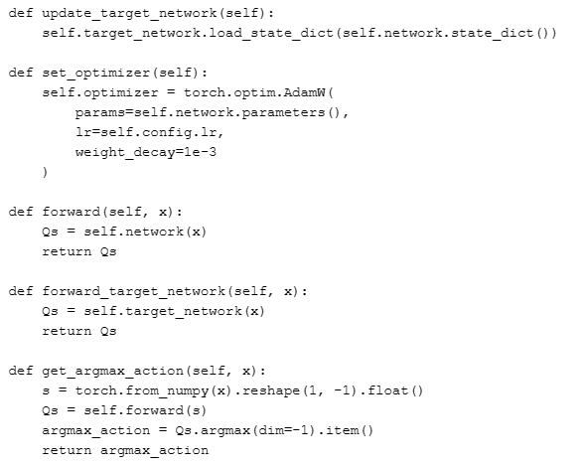
Set decay to prevent overfitting
Network input to nn.Module should be 2 dim.
Get integer value inside Tensor

Slide 36
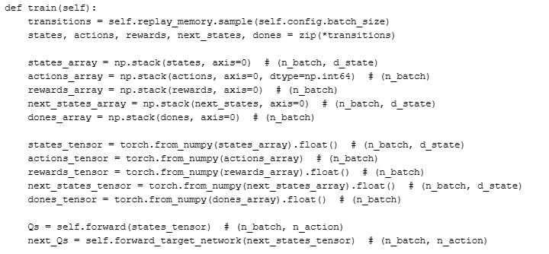
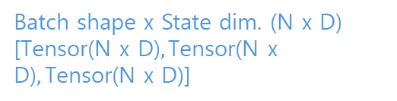
Uniform sampling of Replay buffer
Batch shape x State dim. (N x D)
[$\text{Tensor}\text{(}\text{N} \text{x} \text{D}\text{)},\text{Tensor}\text{(}\text{N} \text{x} \text{D}\text{)},\text{Tensor}\text{(}\text{N} \text{x} \text{D}\text{)}$]
Transform into tensors to put
Into the network
Forward (states_tensor) through Q network. And get Qs output

Slide 37
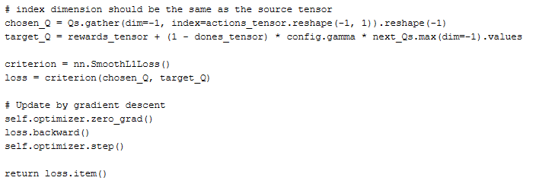
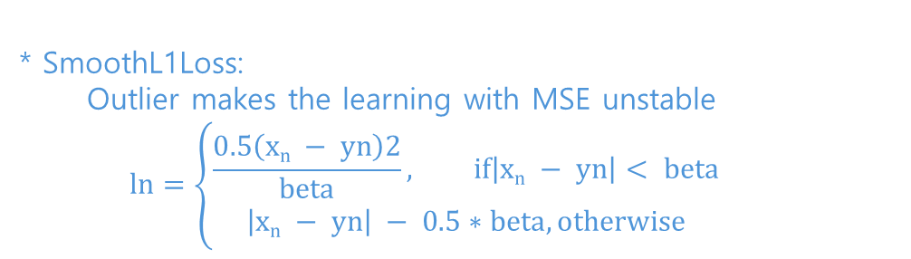
:
(Get Qs for actions taken)
(n_batch, 1)-> (n_batch)
If terminal state, target is just reward, r
* SmoothL1Loss:
Outlier makes the learning with MSE unstable
$$ln=\left\{\begin{aligned}\frac{0.5\left(xn − yn\right)2}{beta}, if\left|xn − yn\right|< beta \\ &\left|xn − yn\right| − 0.5∗beta, otherwise\end{aligned}\right.$$

Slide 38
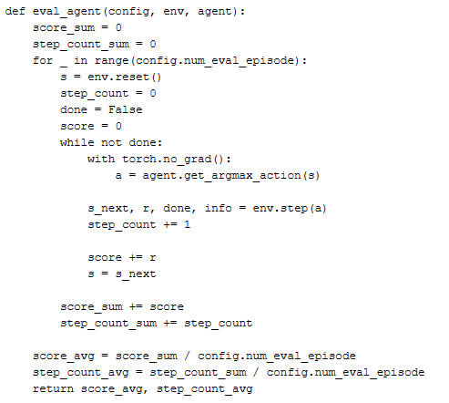
Average after 20 episode evaluation
Set no_grad in evaluation
Argmax action in evaluation

Slide 39
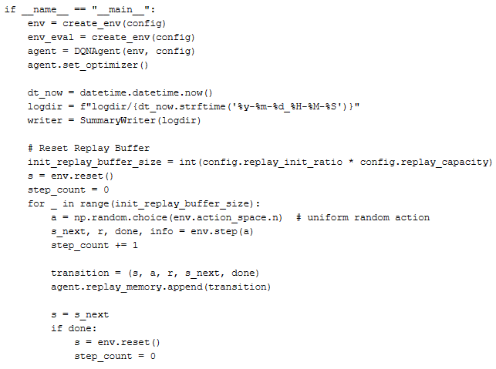
Logging directories
Give the log directory as input
Uniform random action sampling

Slide 40
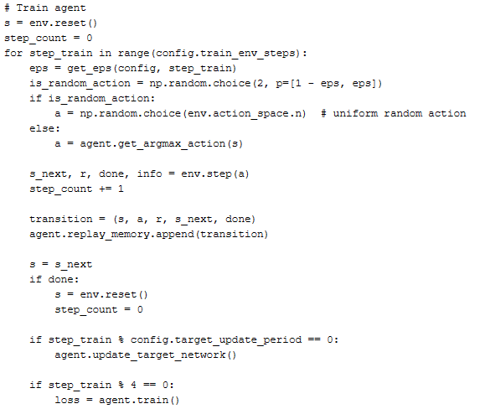
:
Pick random action by Epsilon greedy policy
Update target every 100 steps
Train every 4 transitions

Slide 41
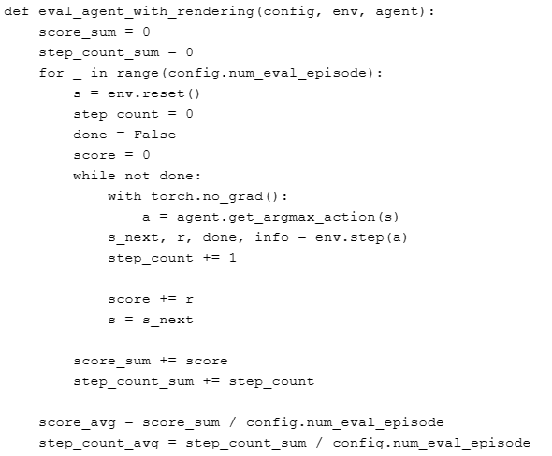
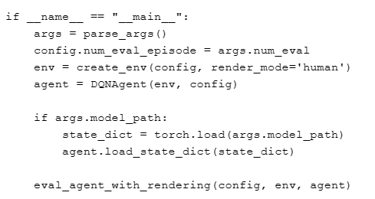
eval.py
Output RGB
(no need call env.render())

Slide 42
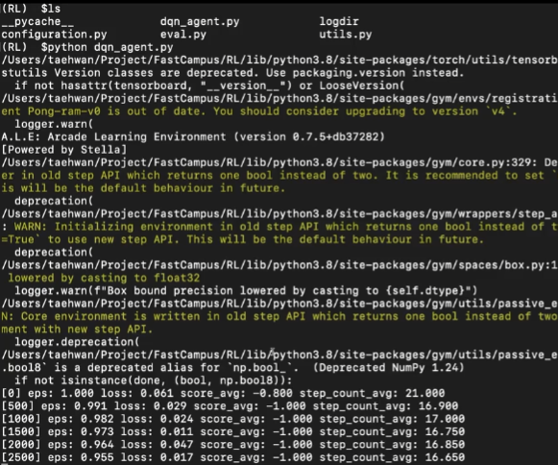
train agent
$python dqn_agent.py
500000 environment step training take about 1 hour in cpu.

Slide 43
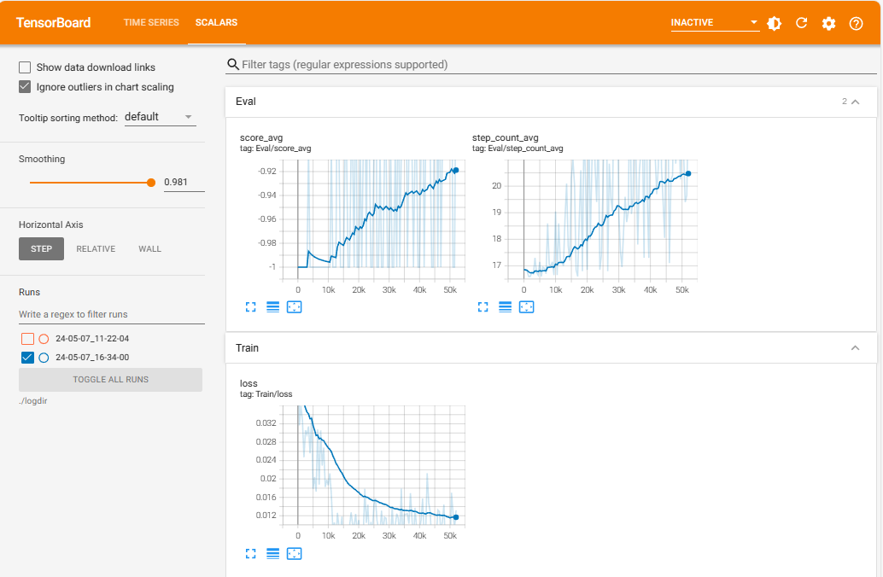
tensorboard
$tensorboard –logdir=logdir
In my case, there was an error, ModuleNotFoundError: No module named 'six’. So, I did ‘pip install six’

Slide 44
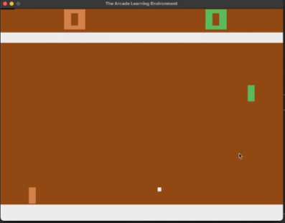
results
$python eval.py –num_eval=5 –model_path=logdir/24-05-07_11-22-04/state_dict.pth

